Slide 1

Phishing Domain Detection
By
Sumeet Sonawane

Slide 2


What is Phishing???
Phishing is a form of cybercrime where attackers deceive individuals or organizations into revealing sensitive information such as passwords or financial details.

Slide 3

Objective
"Developing a model to prerdict whether a domain is real
or fake"

Slide 4

Necessity of Detecting Phishing Domains
Recognizing phishing domains is crucial to safeguard individuals and organizations from falling victim to identity theft, financial loss, and data breaches.

Slide 5

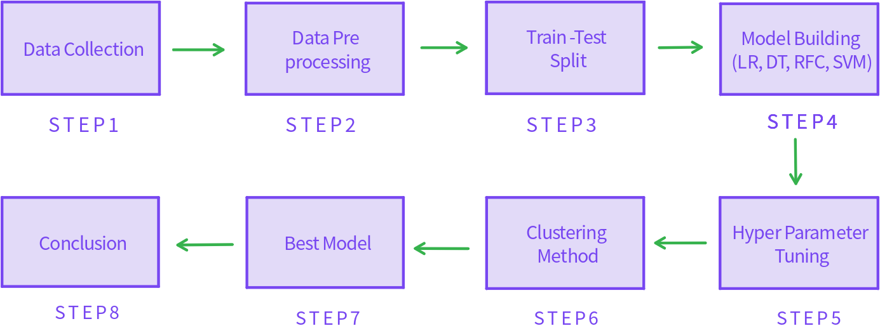
Workflow Chart

Slide 6

Tools and Platforms Used
Tools: Python
Platform: Jupyter Notebook
Library Used: Numpy, Pandas, matplotlib,
seaborn, Scikit-learn

Slide 7

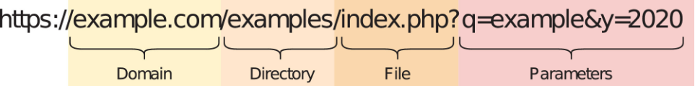
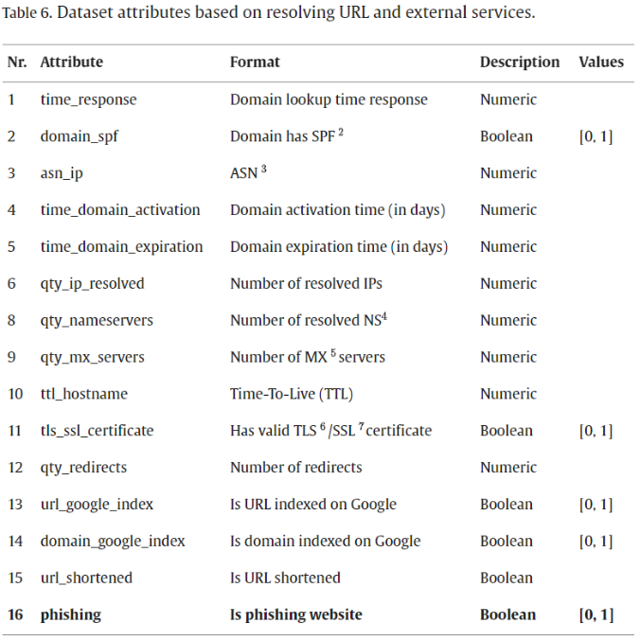
Data Decription

Slide 8

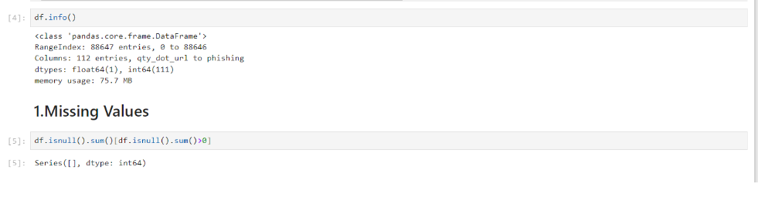
EDA
Checking for nulls and treating them

Slide 9

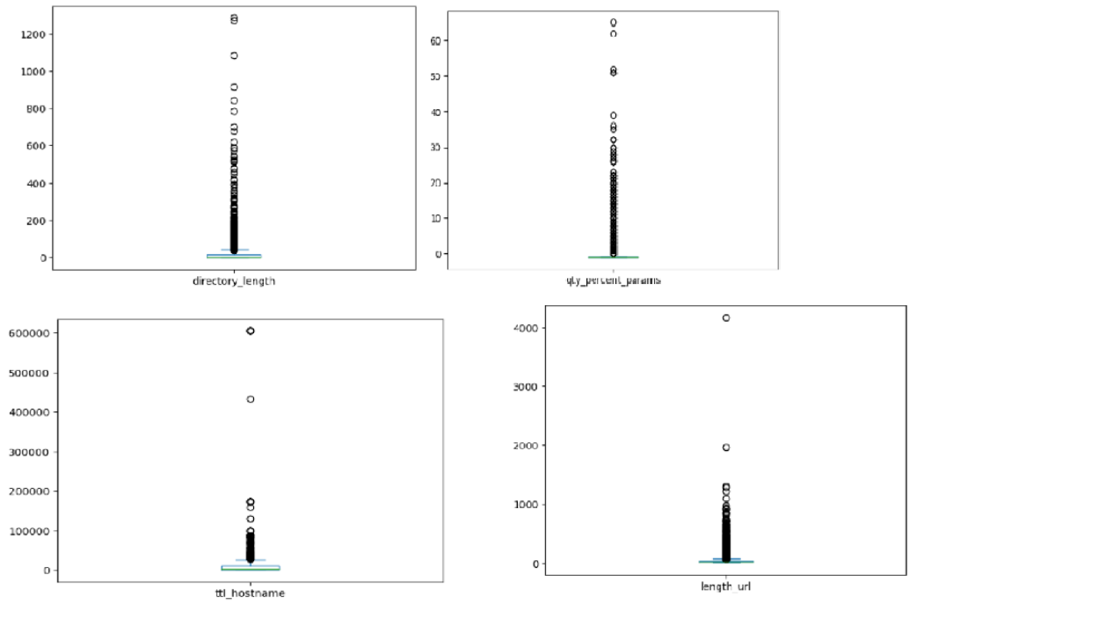
Outlier Removal
Treating outliers using z score

Slide 10

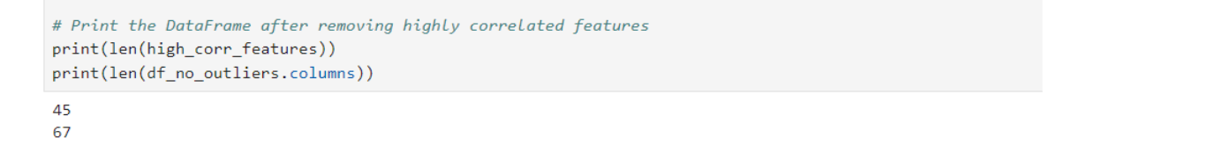
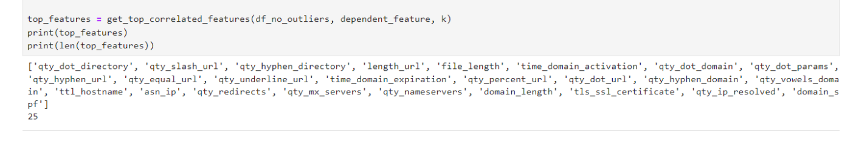
Multicolinearity Removal
Top N correlated Features

Slide 11

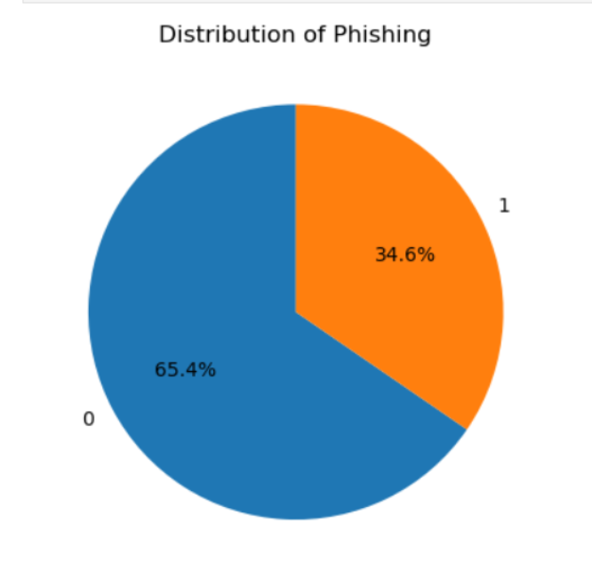
Class Imbalace
Treating Class Imbalance using Smote

Slide 12

Model Building
Algorithm
Accuracy
Recall Score
Precision
Logistic Regression
92.8%
93.1%
85.5%
Decision Tree
95.6%
94.3%
92.7%
Random Forest
97.0%
95.7%
94.5%
Support Vector Machine
95.8%
94.8%
92.0%

Slide 13

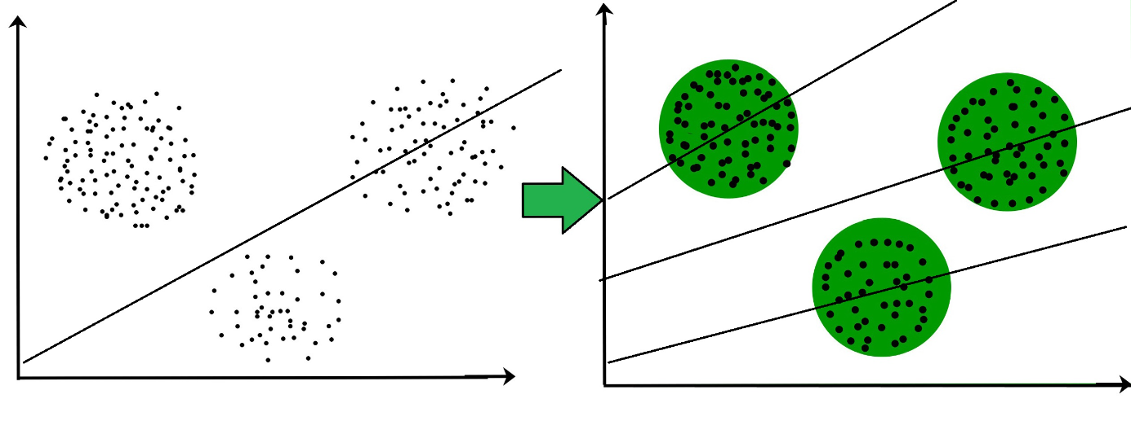
Clustering Method

Slide 14
Best Models
Algorithm
Accuracy
Recall Score
Precision
Random Forest(Hyper tuned)
97.1%
96.0%
95.0%
Cluster Method
97.0%
95.0%
95.4%

Slide 15
Limitations
Clustering Method has high time and
energy consumption

Slide 16

Future Scope
Create an end to end product.
Study new trends.

Slide 17

Conclusion
Detecting phishing domains is essential for preventing cyberattacks. By leveraging machine learning techniques and evaluation metrics, effective defenses can be built.

Slide 18

Thank You…..!!!!

